Slide 1
Login and Payment Method addition steps
Here are the details regarding the meta account for adding the payment method :- 1. https://business.facebook.com/latest/business_home?nav_ref=bm_home_redirect&bm_redirect_migration=true&business_id=1426904268523413&mio=0
login onto this site using the login using facebook option Email :- romil.agarwal@nvtpower.com pass :- Nipl100$

Slide 2
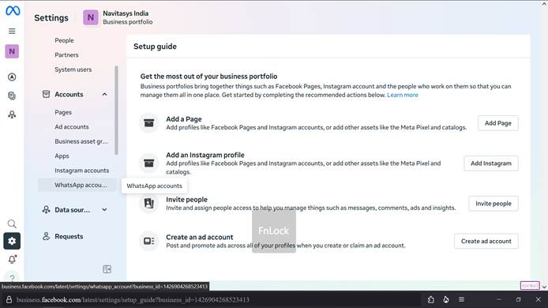
Post Login , go to Setting from the icon shown below , then to whatsapp account

Slide 3
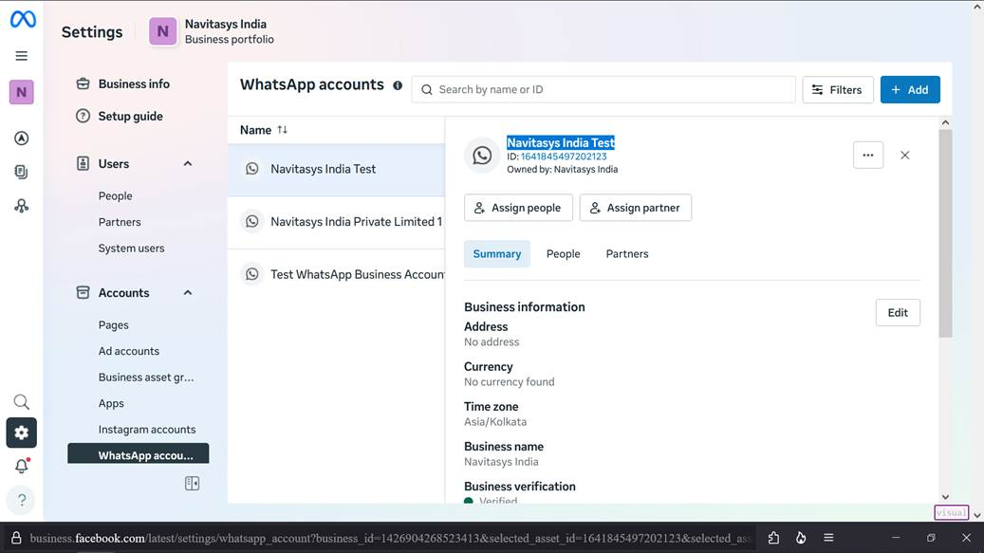
3. Select Navitasys India Test from the list and then select payment setting from the available options

Slide 4
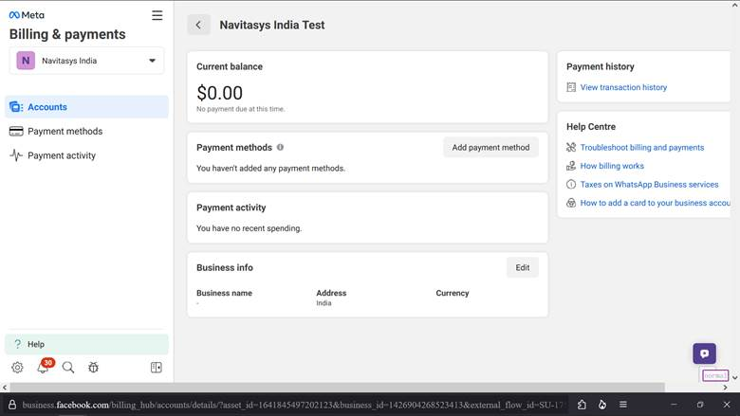
4. It will redirect you to a page and here you can choose the add payment method option .

